Slide 1


WICSE SHADOWING FINAL PRESENTATION
Zoe Brown

Slide 2
Introduction
Mentor: Karina Alverez Silverstein
Year: 3rd year
Major: Computer Science
Minor: Digital Arts and Science

Slide 3

Overview
Research Question:
How can I sync data between a non-relational database and a relational database with as little time complexity as possible to be highly performant

Slide 4

Overview
Goal:
Identify methods / techniques to sync 2 different data stores:
Real time
0% data loss in replication
Balance and control measures

Slide 5






Updated Tech Stack
Technology:
Languages: Java, Scala, Javascript
Databases
Couchbase (Non-relational DB)
PostgreSQL (Relational DB)
Backend
Kafka / Spark (Data migration)
Spring boot (Rest API)
Frontend
Vue.js

Slide 6
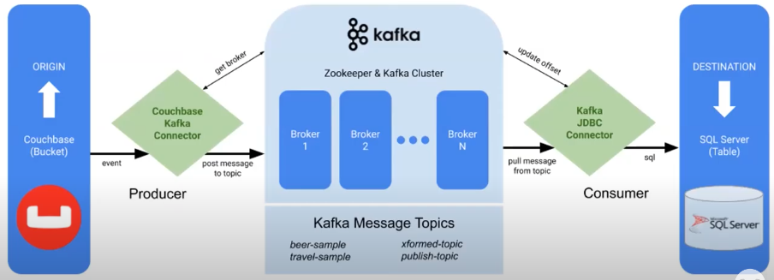
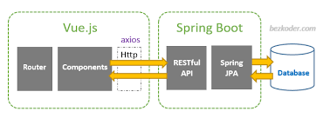
System Architecture

Slide 7
Progress
Connected/configured Couchbase to Kafka
Connected/configured Spark to ingest data from Kafka and produce to PostgreSQL
Set up Spring boot to connect to Couchbase and Postgres
Added attributes for input and out time to calculate Latency
Created Vue website and used Axios to receive API endpoints
Used SQL to calculate min, max, avg, and 90th percentile latency

Slide 8




Challenges
UNDERSTANDING
SETUP
Fixing bugs
TIME
All new frameworks that are complex
Lots of configurations!!
Limited knowledge made understand errors difficult
Balancing work

Slide 9
Demo

